Slide 1
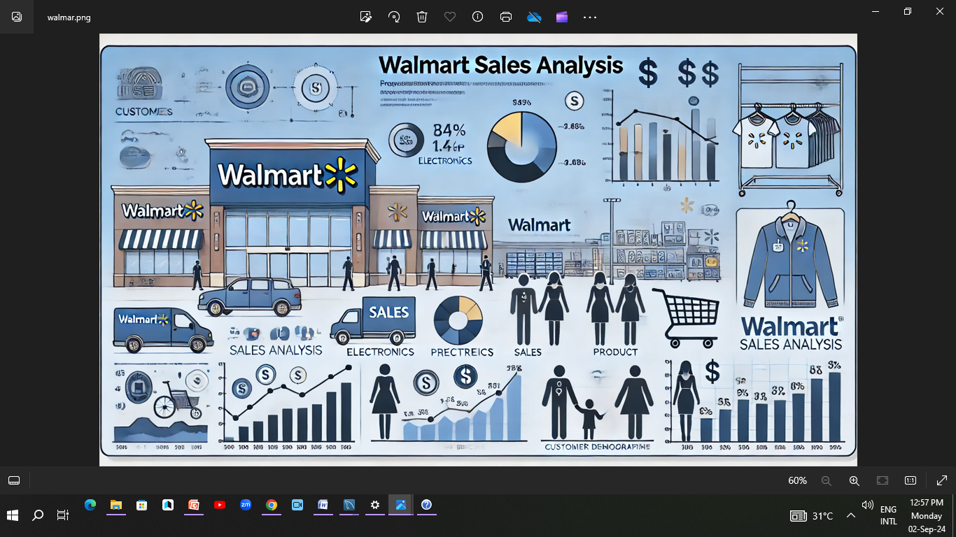

Slide 2

Project 1: Analyze Walmart Sales Data To analyze and derive insights from Walmart's sales data to improve business decision-making processes. Dataset: • The dataset consists of the following columns: • Invoice_ID: Unique identifier for each invoice. • Branch: Branch of the store where the sale took place. • City: City where the store branch is located. • Customer_type: Type of customer (e.g., Member, Normal). • Gender: Gender of the customer. • Product_line: Category of the product sold. • Unit_price: Price per unit of the product. • Quantity: Quantity of the product sold. • Tax_5%: Tax applied on the sale. • Total: Total amount of the sale. • Date: Date of the transaction. • Time: Time of the transaction. • Payment: Payment method used (e.g., Cash, Credit Card). • cogs: Cost of goods sold. • gross_margin_percentage: Gross margin percentage. • gross_income: Gross income from the sale. • Rating: Customer rating for the purchase.

Slide 3
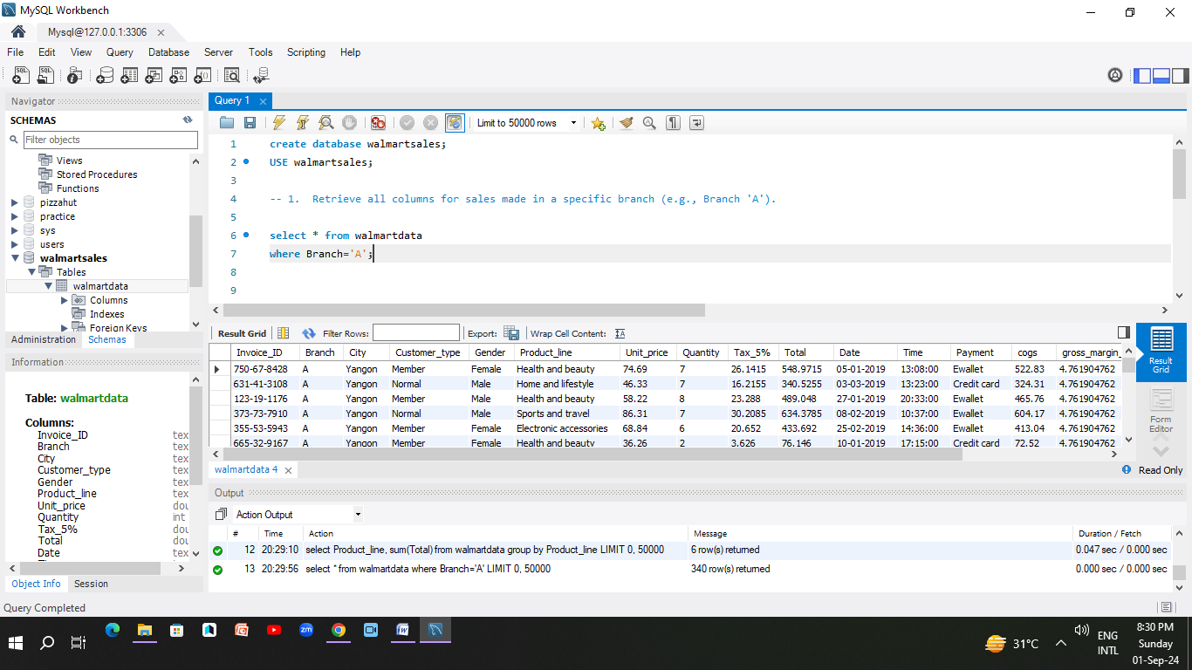
1. Retrieve all columns for sales made in a specific branch (e.g., Branch 'A').

Slide 4
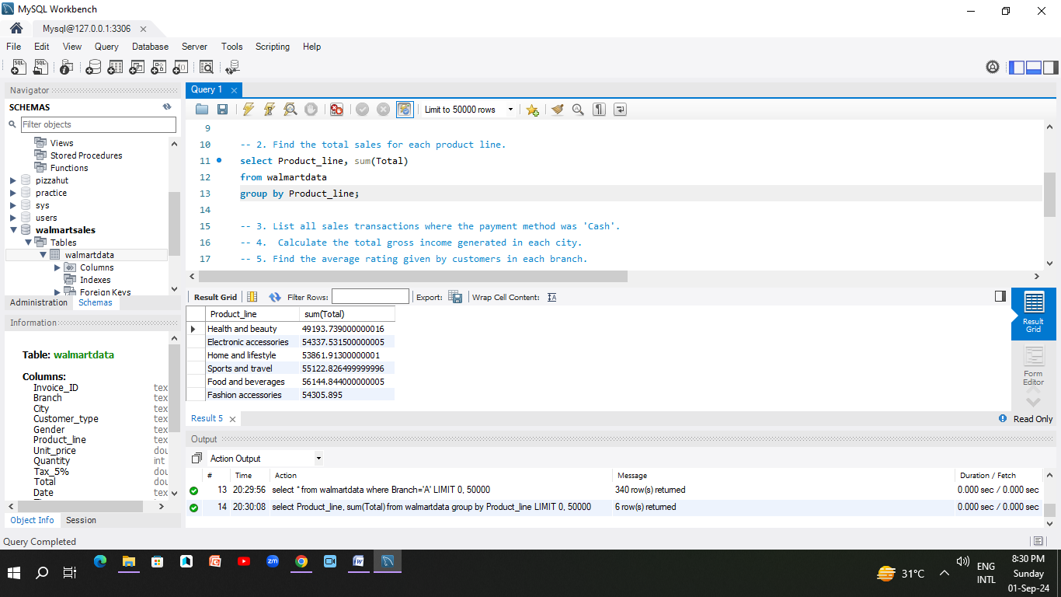
2. Find the total sales for each product line.

Slide 5

3. List all sales transactions where the payment method was 'Cash'.

Slide 6
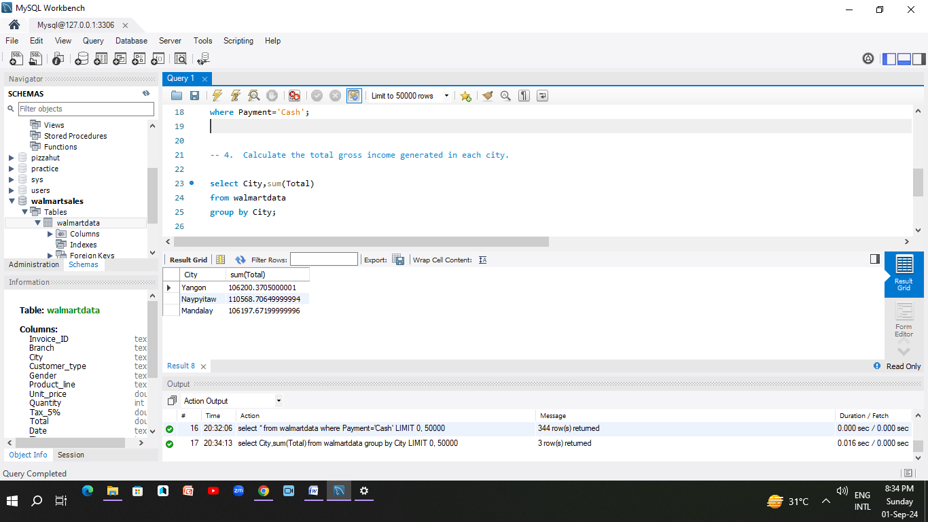
4. Calculate the total gross income generated in each city.

Slide 7
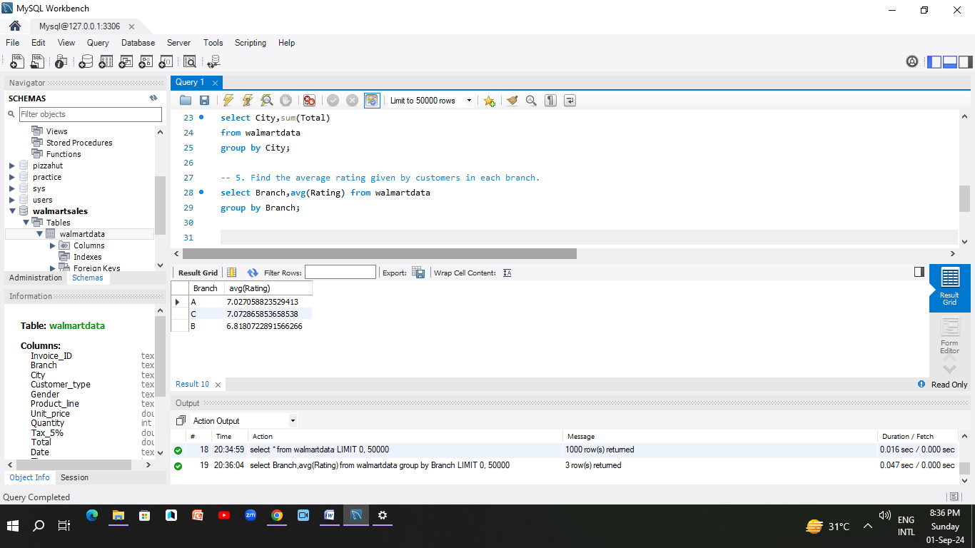
5. Find the average rating given by customers in each branch.

Slide 8
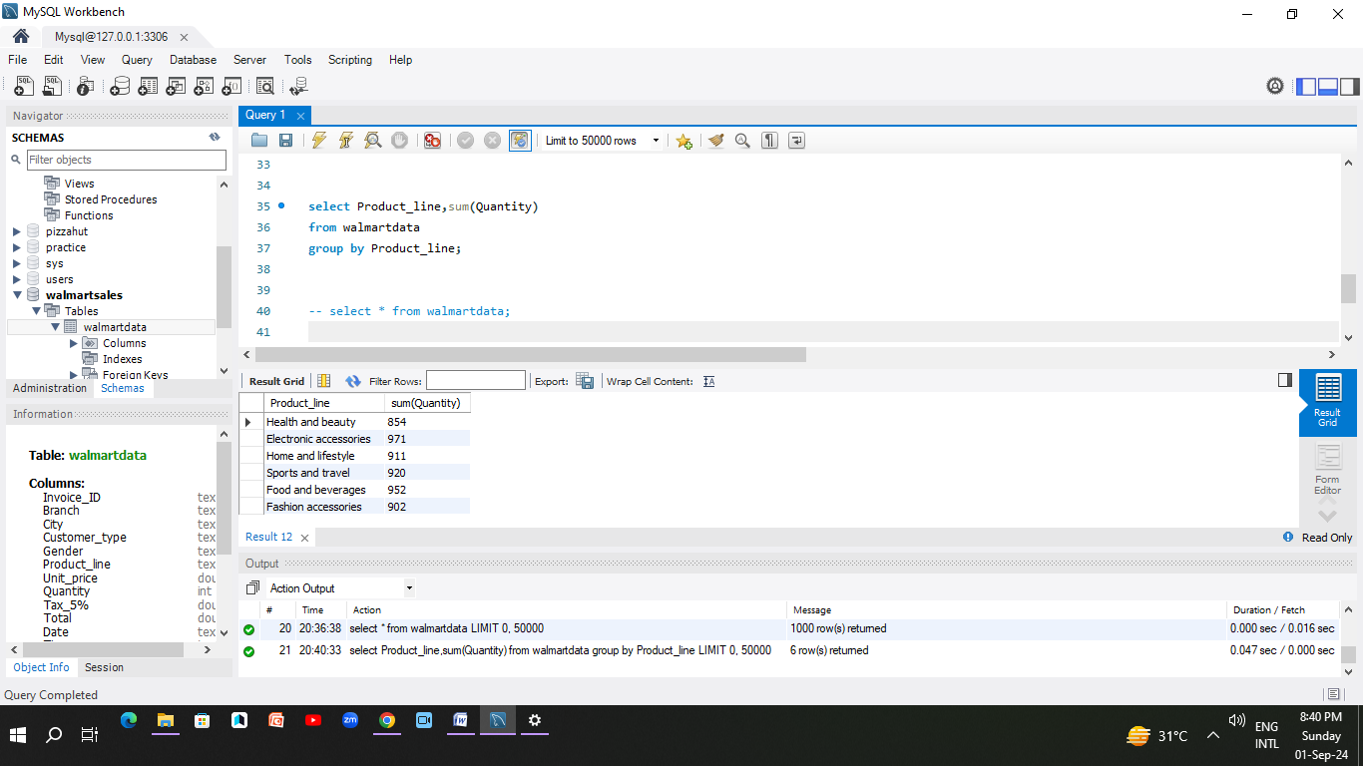
6. Determine the total quantity of each product line sold.

Slide 9
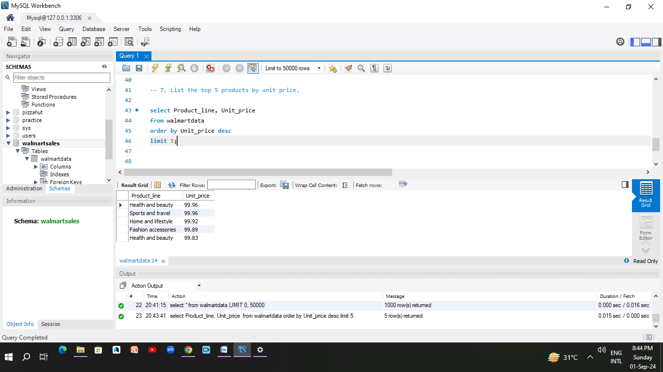
7. List the top 5 products by unit price.

Slide 10
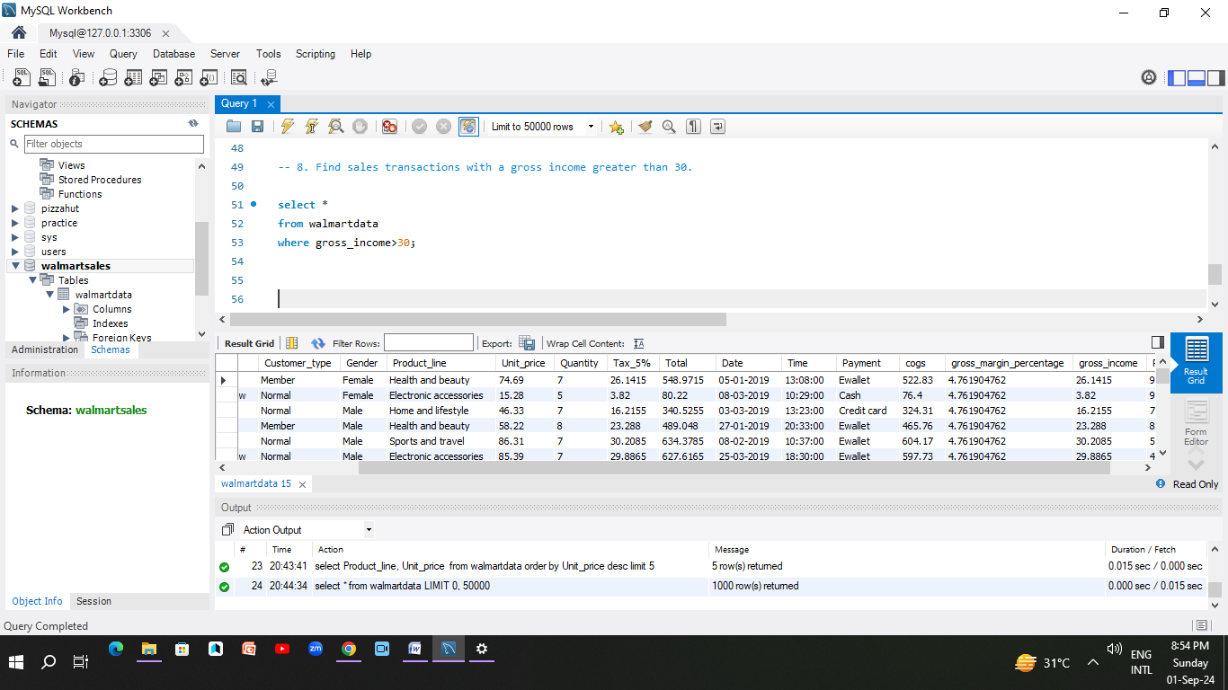
8. Find sales transactions with a gross income greater than 30

Slide 11
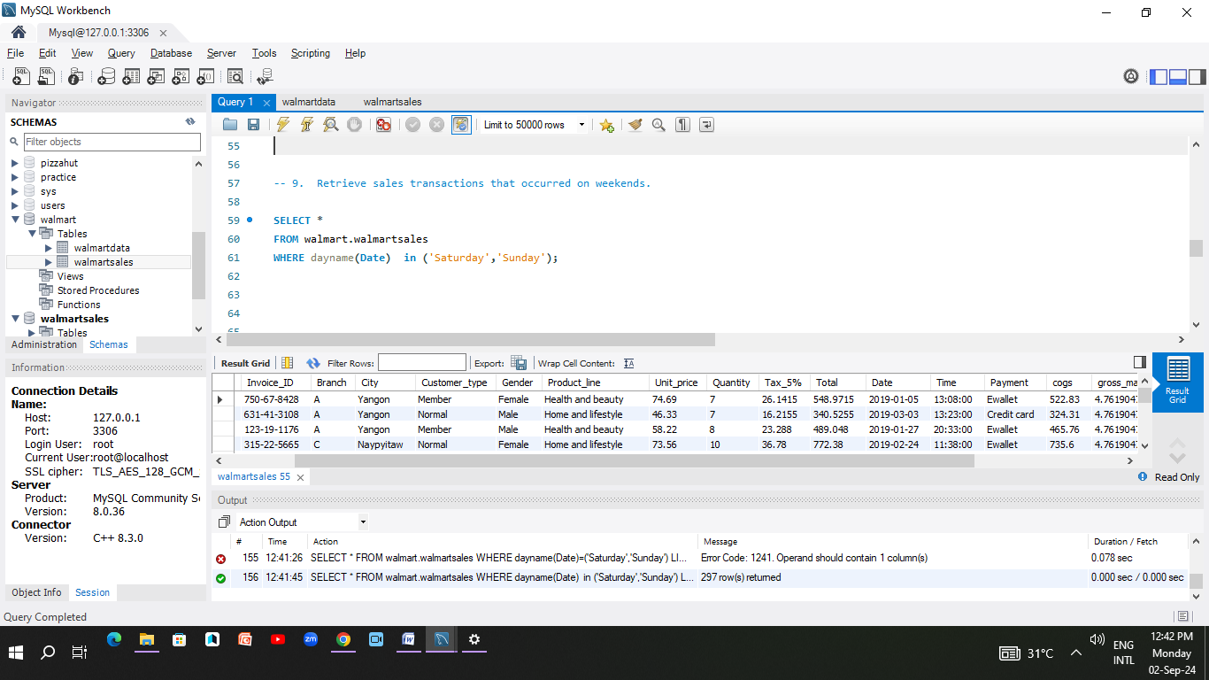
9. Retrieve sales transactions that occurred on weekends.

Slide 12
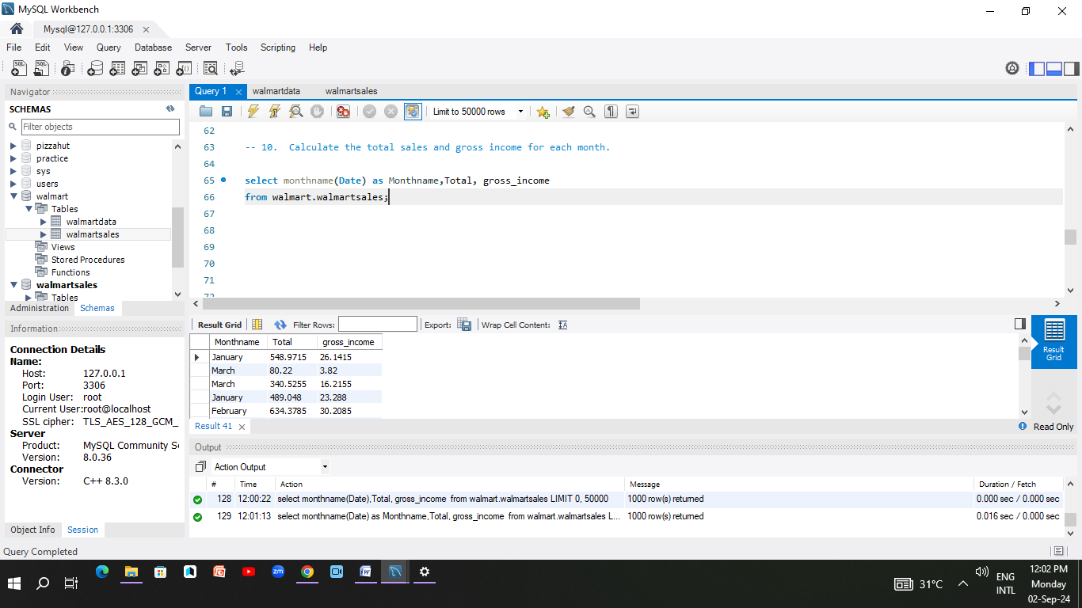
10. Calculate the total sales and gross income for each month.

Slide 13
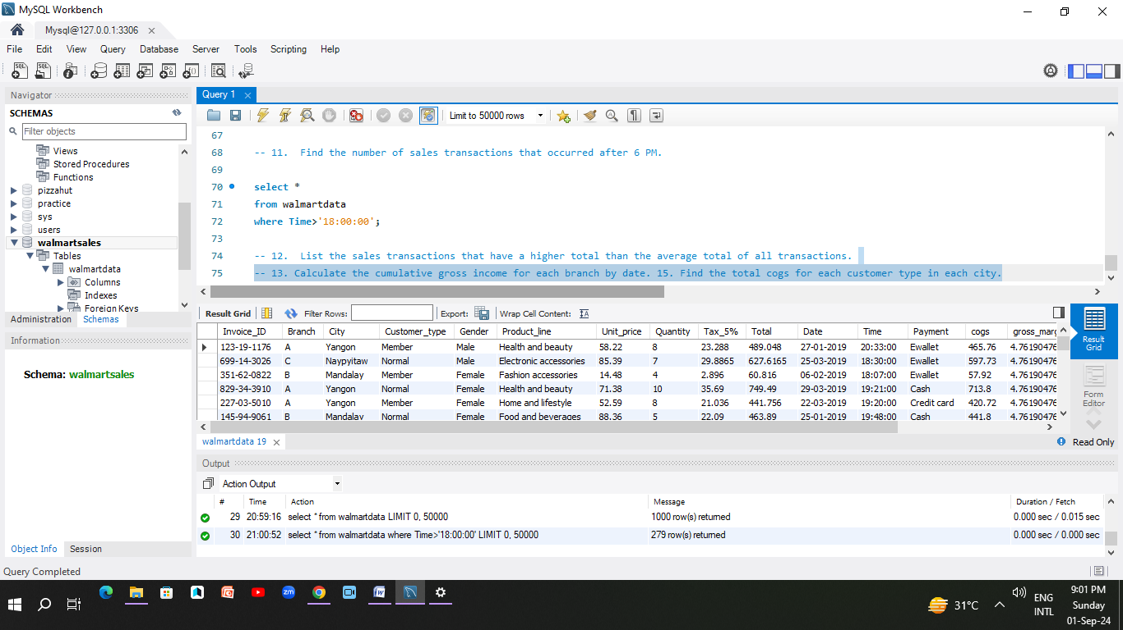
11. Find the number of sales transactions that occurred after 6 PM.

Slide 14
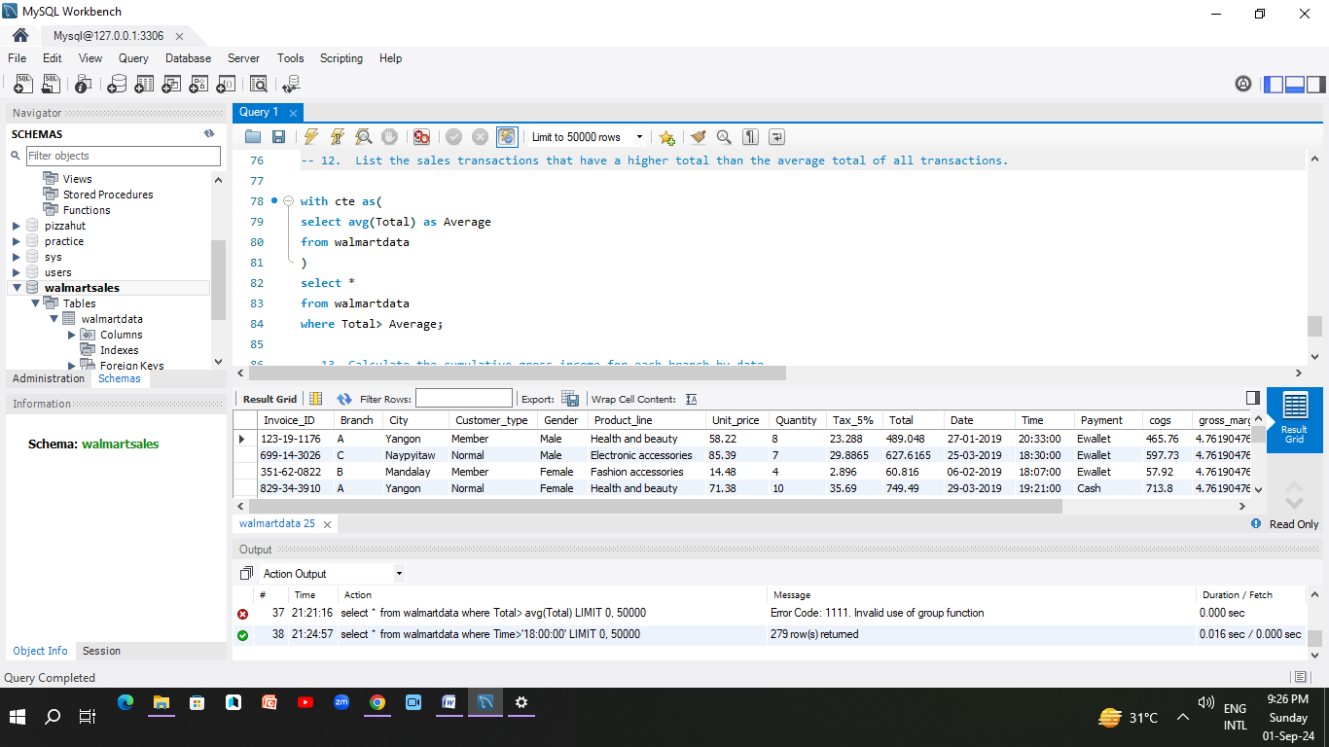
12. List the sales transactions that have a higher total than the average total of all transactions.

Slide 15
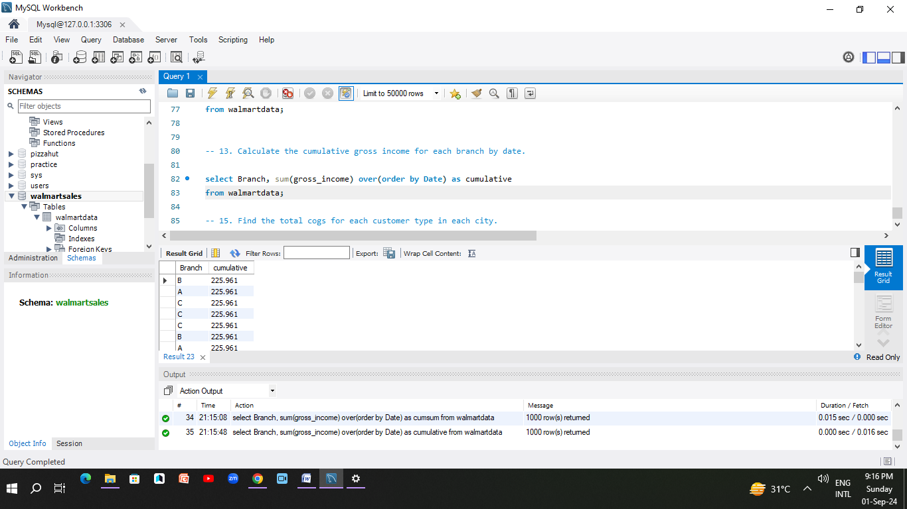
13. Calculate the cumulative gross income for each branch by date.

Slide 16
Conclusion
Based on the comprehensive analysis of Walmart's sales data, the following key insights were identified:
1. Branch Performance: Specific branches, such as Branch 'A,' demonstrated varying levels of sales and gross income, highlighting the need for tailored strategies to boost performance in underperforming locations.
2. Product Line Insights: Certain product lines consistently outperformed others, contributing significantly to overall sales. Identifying and promoting these top-selling product lines can drive further growth.
3. Payment Preferences:Cash transactions played a notable role in sales, indicating the importance of maintaining diverse payment options to cater to customer preferences.

Slide 17
Conclusion
3. Customer Satisfaction: Branch-specific average ratings indicate varied customer satisfaction levels. Focusing on improving the lower-rated branches could enhance overall customer experience.
Sales Trends: Sales data showed clear trends, such as increased weekend transactions and notable sales peaks, guiding Walmart in optimizing staffing and stock management during high-traffic periods.
High-Value Transactions: Identifying high-gross income transactions provides insights into premium products and services, offering opportunities for upselling and premium marketing strategies.
6. Time-Based Analysis: Sales after 6 PM and monthly performance insights can help in adjusting operating hours and promotional efforts to better align with customer behavior patterns

Slide 18
Recommendations
Enhance High-Performing Categories: Focus marketing efforts on the top-selling products and high-grossing cities to maximize revenue.
Improve Customer Experience: Address customer feedback and improve service quality in branches with lower ratings.
Optimize Operational Strategies: Adjust inventory, staffing, and promotional strategies to capitalize on identified sales trends.
By leveraging these insights, Walmart can refine its sales strategies, improve operational efficiency, and enhance overall customer satisfaction, driving future growth and success.

